Slide 1
Opening Restaurant in Bucharest
- Vishvam P Naik

Slide 2
Business Problem
Bucharest is the capital and biggest city of Romania, as well as its cultural, industrial, and financial center having 1.883.425(2018) population.
Opening new restaurant in Bucharest may be profitable for restaurant owner. Our problem is Where to open restaurant in Bucharest?

Slide 3
Data Sources
We get the neighborhood data of Bucharest from Wikipedia
We use python geocoder library to get geographical coordinates of neighborhoods
We use Foursquare API venues method to get ranks and likes of restaurants by given venue id.
We use Foursquare API venues explore method to get the venues of given neighborhoods of Bucharest.

Slide 4
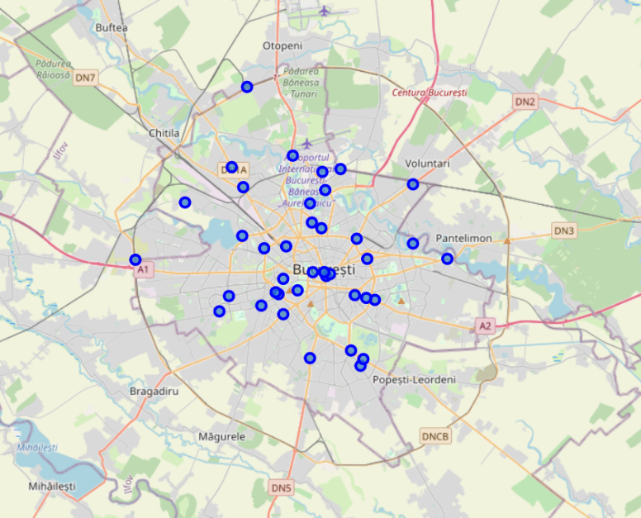
Methodology
• The Bucharest data is available with the neighborhood name in Wikipedia. Location information (latitude and longitude) of neighborhoods are taken from geocoder library.
• Took neighborhood from Wikipedia and put blue dots on Bucharest map to see centers of neighborhoods. There are 40 neighborhoods in Bucharest

Slide 5
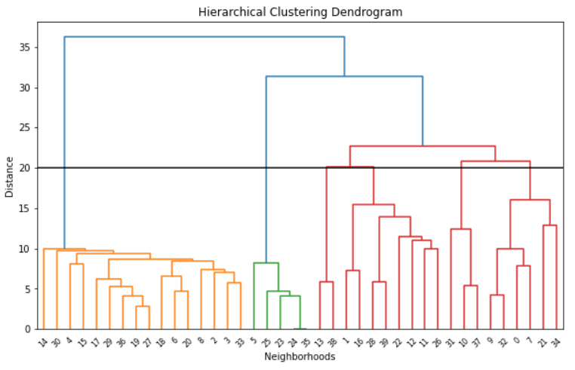
Methodology - Clustering
Used Agglomerative Clustering to cluster neighborhoods according to count of venue categories in each neighborhood. According to the below graph, I decided to separate our neighborhoods into 6 clusters (cut at distance of 20, horizontal black line)

Slide 6
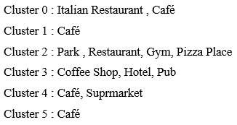
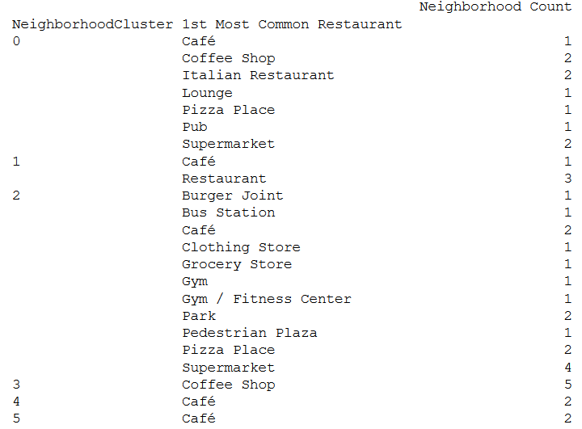
Methodology - Clustering

Slide 7
Results
Total number of restaurants: 477
Total number of Turkish restaurants: 22
From maps, we can see that there are
Too many restaurants in 4 km to the center
Enough restaurants between 4-6 km to the center
There are not many restaurants after 6 km to center
Turkish restaurants are located in South, North , East, between 2-4 Km distance around center
There are not Turkish Restaurants in West and North West part
Some Turkish restaurants gets bad points. That means people do not prefer these restaurant too much and any turkish restaurant may be opened around

Slide 8
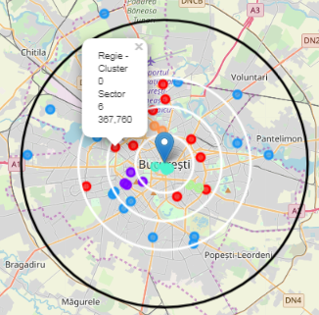
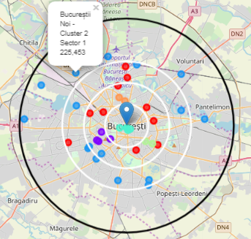
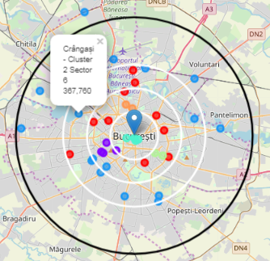
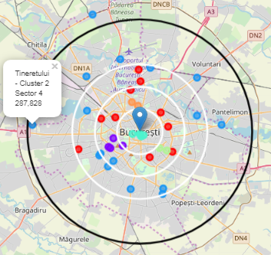
Conclusion
We have chosen 4 locations for opening Turk restaurant. Below are locations of neighborhoods. Hope this work will help somebody who wants to open a new ethnic restaurant in Bucharest.

